Slide 1
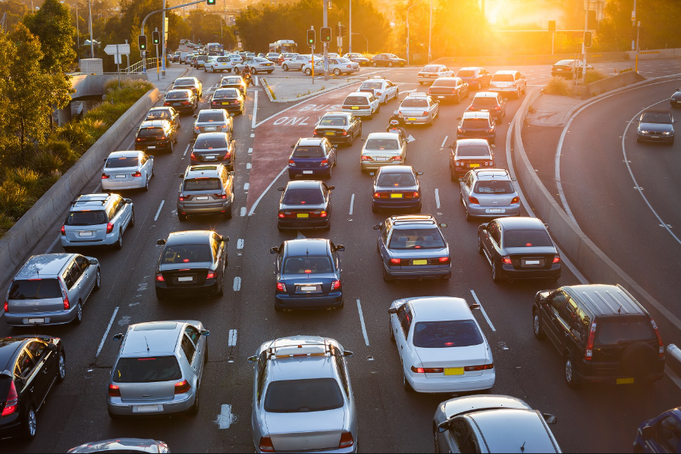

AUTOPATROL
AI-POWERED TRAFFIC VIOLATION MONITORING
TEAM : C1
22R21A05F3 - K SATHISH
22R21A05F8 - K SAI PRAKASH
22R21A05G7 - M AKSHAY KUMAR
22R21A05G9 - M MANOBHARATH
Guide: Mr. P. MICHEAL PREETAM RAJ

Slide 2

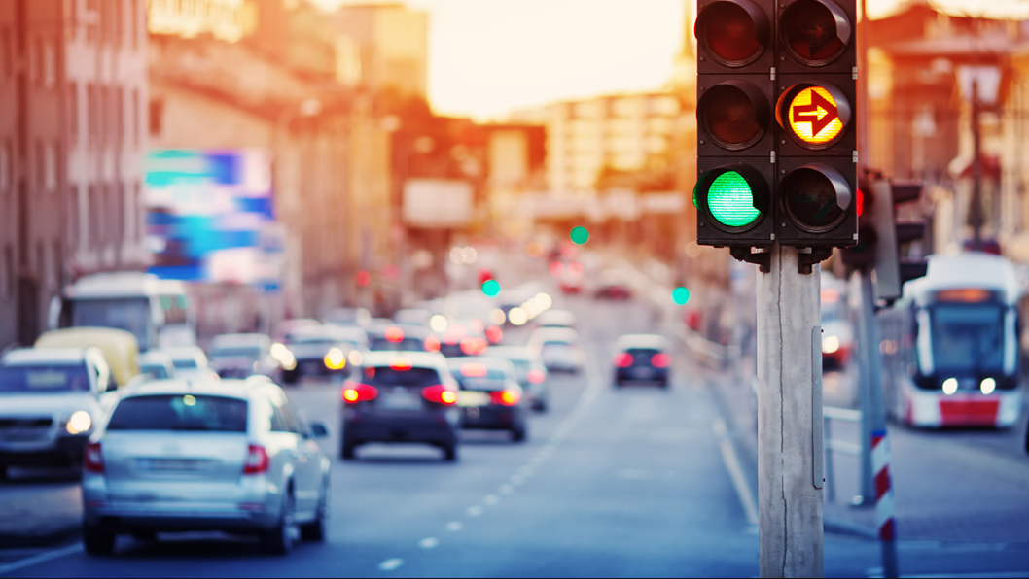
Introduction
Traffic congestion is a major challenge in urban areas.
Traditional traffic signals operate on fixed timings, causing inefficiencies.
Manual enforcement of traffic rules is error-prone and requires high manpower.
Smart technology can optimize traffic flow and improve law enforcement.

Slide 3

Literature Survey
S. No. | Paper Title | Author(s) | Methodology | Findings/Limitations
1 | AI-Based Smart Traffic Control System | John Doe et al. (2020) | Used YOLO for object detection and machine learning for traffic signal control. | Improved traffic flow but struggled in extreme weather conditions.
2 | Automatic Number Plate Recognition using OCR | Smith & Lee (2019) | Implemented EasyOCR and OpenCV for ANPR. | Achieved 85% accuracy but faced issues with low-quality images.
3 | Deep Learning for Vehicle Detection | Patel et al. (2021) | Used YOLOv5 for vehicle detection in urban areas. | Faster detection but required high computational power.
4 | Smart Traffic Monitoring Using IoT and AI | Gupta & Sharma (2022) | Integrated IoT sensors with AI for real-time monitoring. | Effective but had high setup costs and dependency on the internet.
NUMBER PLATE
DETECTION

Slide 4


Problem Statement
SIGNAL MANAGEMENT
NUMBER PLATE
DETECTION
Inefficient timing leads to traffic gridlocks.
Manual adjustments are time-consuming.
Manual entry is prone to errors.
Security concerns with outdated systems.

Slide 5

Existing System vs Proposed Solution
Feature | Existing Systems | Proposed System
Traffic Signal Control | Fixed timer – based signals | AI-based adaptive signal control based on vehicle density
Number Plate Recognition | Manual checking or limited ANPR systems | Automated number plate detection using EasyOCR
Real-Time Adaptability | Cannot adjust to sudden traffic surges or emergencies | Dynamically adjusts based on real-time traffic conditions
Enforcement & Monitoring | Relies on human intervention and static CCTV analysis | AI-powered automated violation detection and reporting
User Interface | Browser-based tools | Interactive UI (Streamlit Web App)

Slide 6
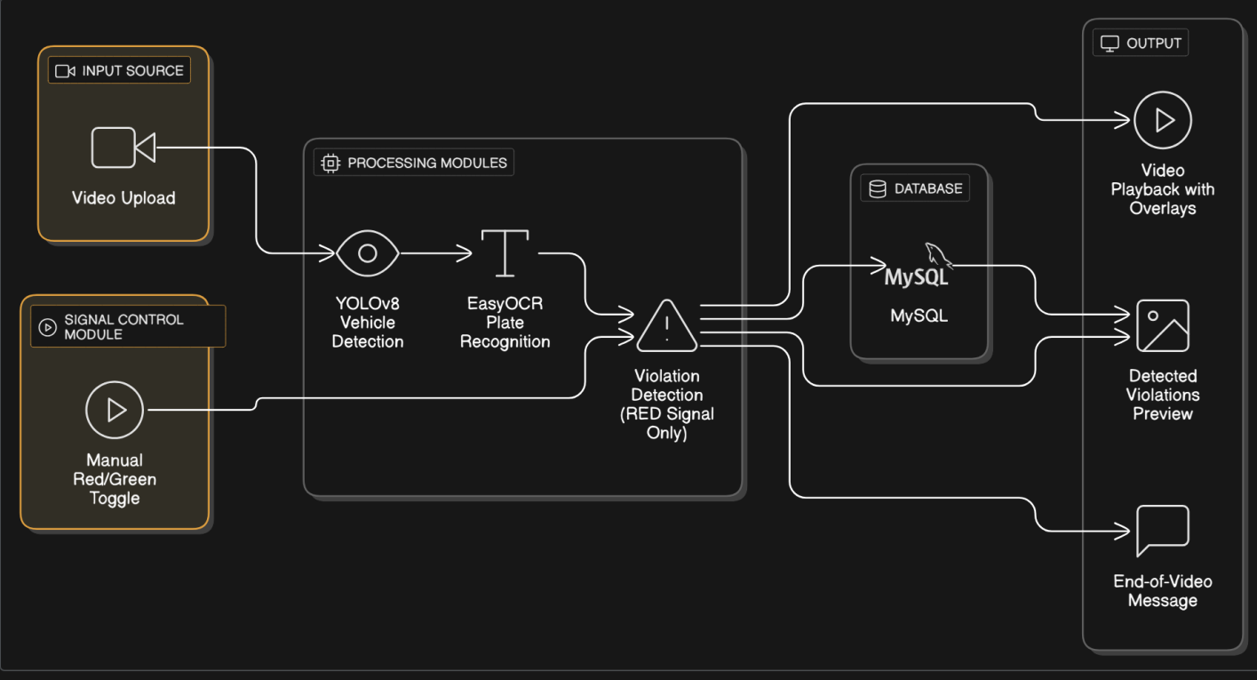
System Architecture

Slide 7
Modules
01
03
Vehicle Detection & Tracking
AI-Powered Traffic Signal Control
02
04
Number Plate Recognition
Violation Detection & Reporting

Slide 8


Software Requirements
Python
VS Code
Streamlit
Ultralytics
OpenCV
EasyOCR

Slide 9

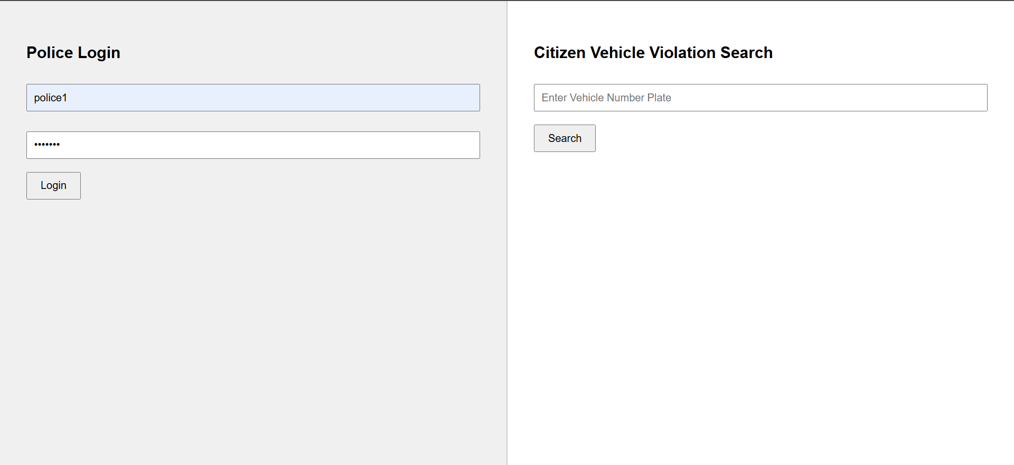
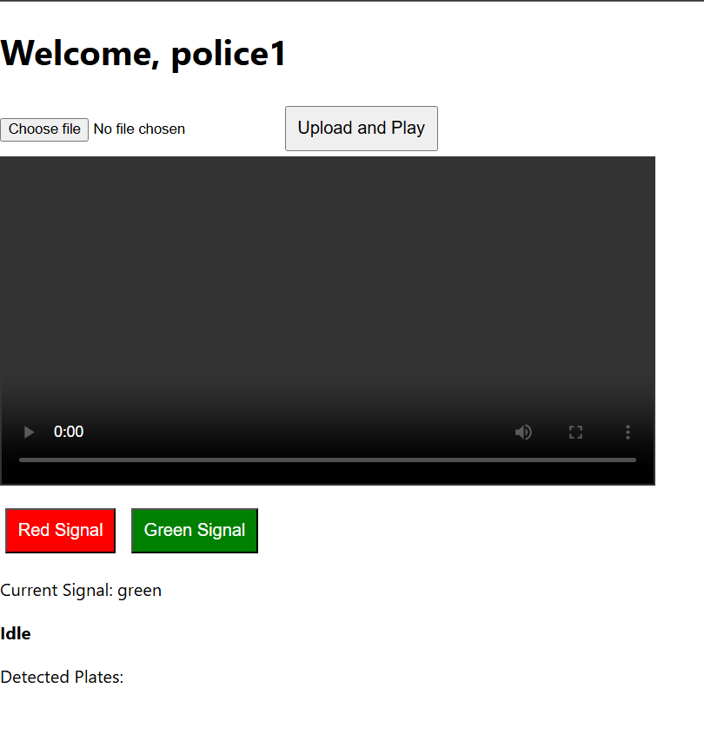
Implementation

Slide 10
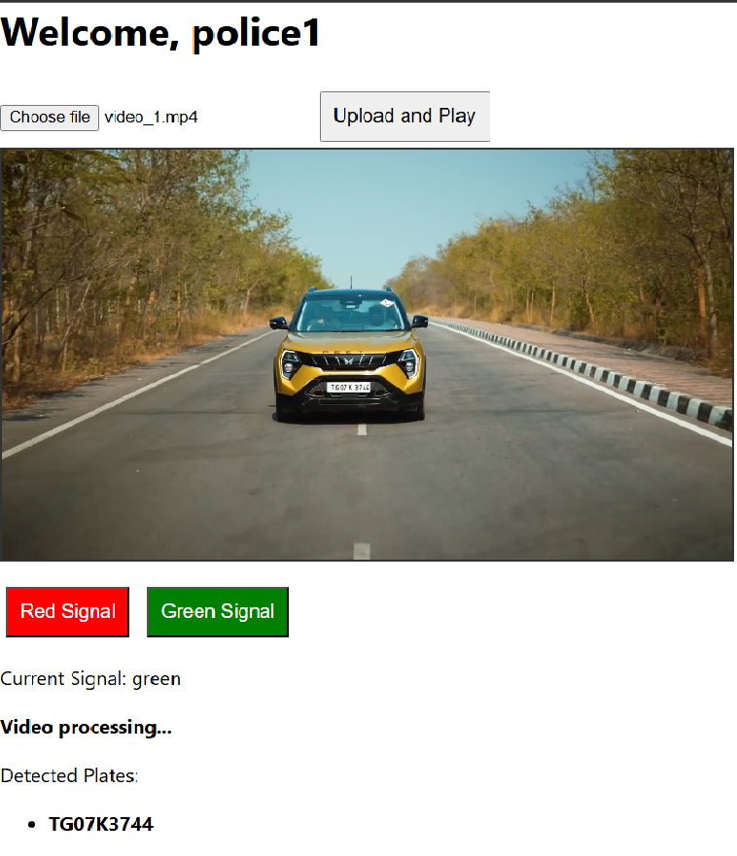
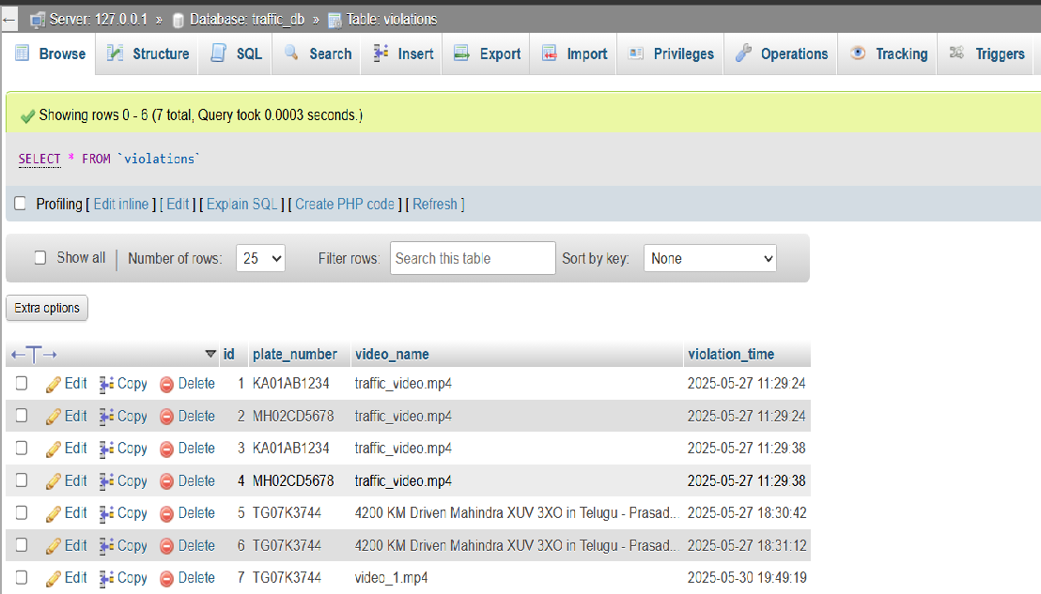
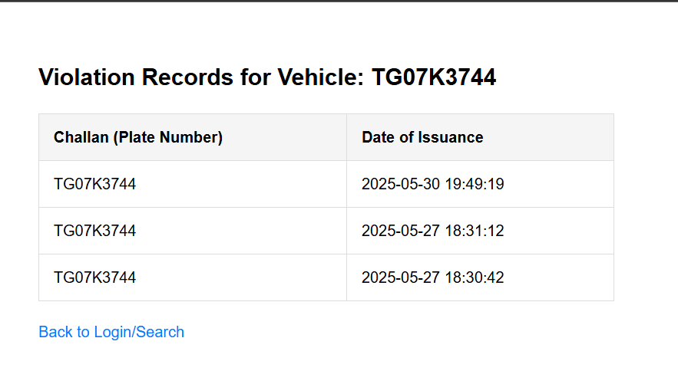
Implementation

Slide 11
Future Works
AI-Based Traffic Control
Real-Time Vehicle Detection
Automatic Number Plate Recognition (ANPR)
Automated Fine System
More violations to be observed like triple riding, no helmet

Slide 12

THANK YOU

